Slide 1

Presentation skills
Would you like to be able to give an amazing presentation?
You’ll improve!
You’ll gain confidence!
Your grades will skyrocket!
You’ll feel safe and secure doing it!

Slide 2

Comfort lies in preparation
Have a great slide show
Practise
Learn a couple of tricks

Slide 3
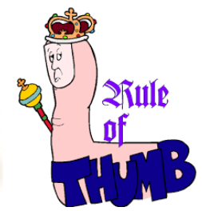
The great slide show – basic rule!!!
10 – slides
20 – minutes
30 – size of letters

Slide 4


The great slide show – WHAT?
What is your key message?
What do you offer the audience?
Repeat it in the beginning, in the middle and in the ending

Slide 5

The great slide show – How?
Limit your contents
Or you’ll lose people…
Only include contents that explain your key message

Slide 6

The great slide show – How?
Spend a lot of time on your introduction and your ending
This is when people pay attention!
One method is to start out with a rhetorical question

Slide 7
How do you practise?
Use the 20 – 20 – 20 rule
  Go through your slideshow and visualize what you are going to say (20 minutes)
  Give your presentation ORALLY in front of a mirror (20 minutes)
  Give your presentation ORALLY in front your friends (20 minutes)
            Now you know that you know your shit!!!

Slide 8



Gestures and voice
Use your hands
A way to keep the audience focused
    Pretend that you are holding a paper clip between your index finger and your thumb
Speak loud and clear – and not too fast. This way the audience has time to think about what you say
(reduces nervousness/anxiety, fast breathing and dry mouth)

Slide 9
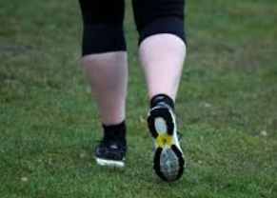


Posture
Position in room
Conquer the room
Open
People are going to want to listen to you

Slide 10

We’ll construct great slide shows, practise and build confidence

Slide 11
Epic public speaking fail: Miss South Carolina at Teen USA 2007
https://www.youtube.com/watch?v=tugtpwAt-xA
Good Presentation VS Bad Presentation
https://www.youtube.com/watch?v=V8eLdbKXGzk
How to Start Your Presentation: 4 Step Formula for a Killer Intro
https://www.youtube.com/watch?v=aGEFtRwPhE4

